Slide 1
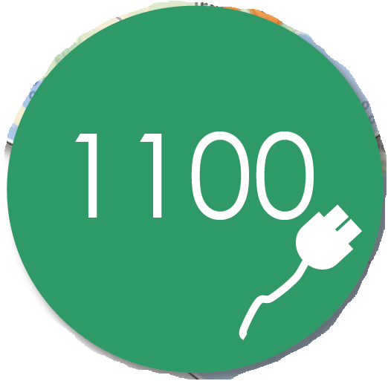

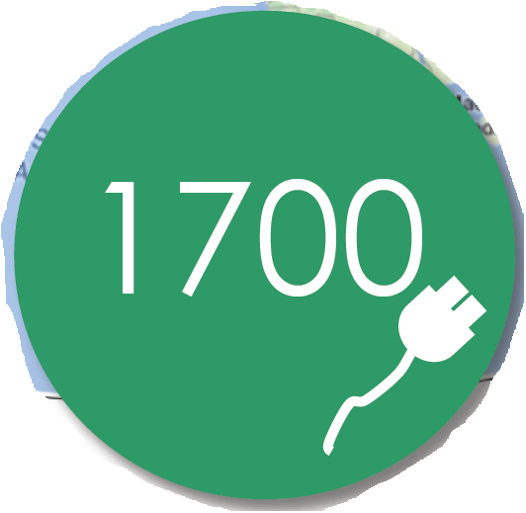

Slide 2
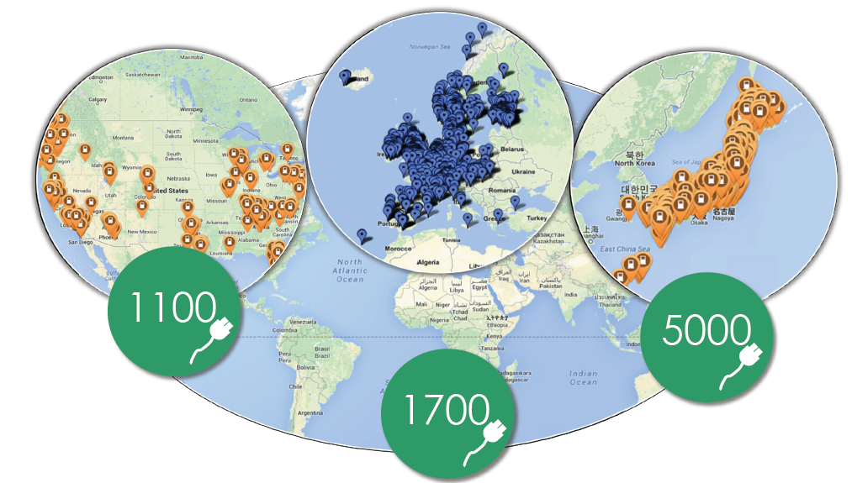

Slide 3


Slide 4
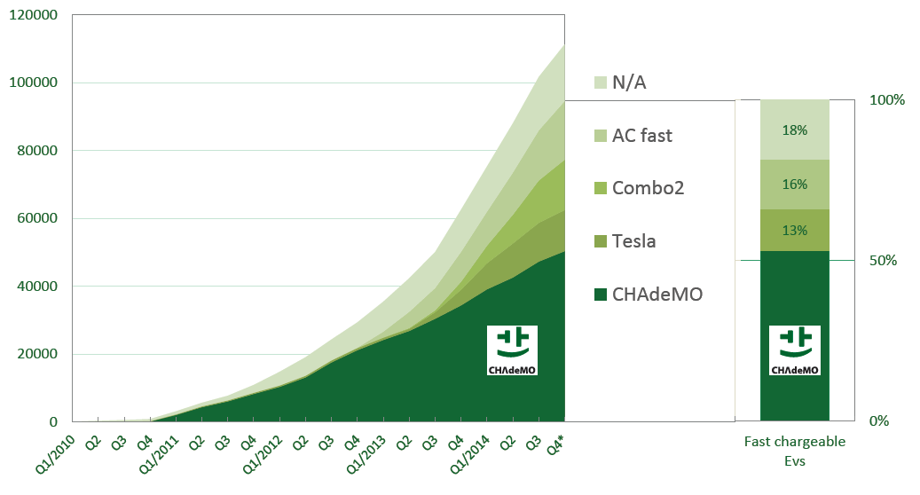
European EV sales by fast charging type (cumulative) 2010-2014

Slide 5
European EV sales by fast charging type (cumulative) 2010-2014

